Slide 1
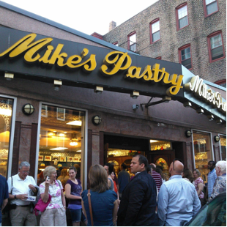
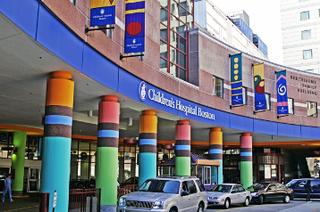
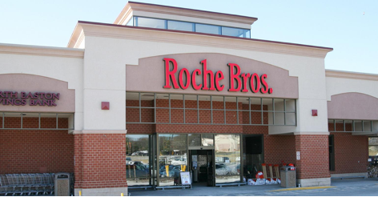
Boston
Basic Economy
Hospitals
Higher Education
Semiconductor/Electronic component manufacturing
Non-Basic Economy
Mike’s Pastry
Roche Brothers

Slide 2

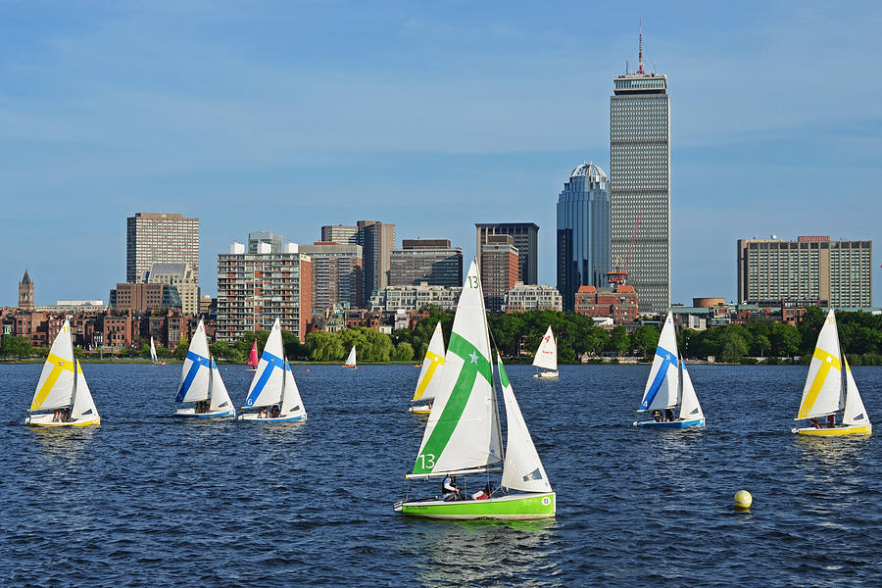
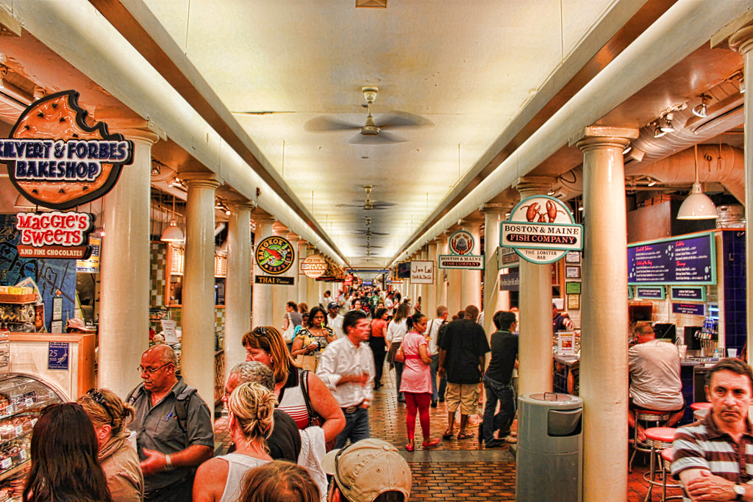

Boston 2.0
Non-Basic Economic Activities:
Boston Sports —- Boston has very strong sport teams is a big part of Boston’s identity. Millions of dollars in ticket sales are sold every year
Boat Rentals on the Charles —- The Charles River is a river that runs through a lot of Massachusetts with its most iconic strip cutting through Boston. On it, people can rent canoes, kayaks, row boats, sailboats, you name it. You can also take a tour on the famous Boston Duck Tours, which go both on land and on the water.
Basic Economic Activities:
Food — Quincy Market in Faneuil Hall is home to many local food shops and restaurants. It is a major tourist destination, as well as just a fun place to hang out and get food.
Colleges — Boston is famous for having some of the best colleges and universities in the country. Harvard, MIT, BC, and BU are just a few of the top programs in the state with hundreds of smaller more niche colleges as well.

Slide 3
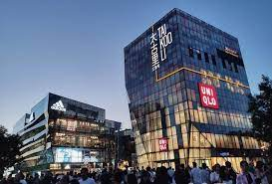
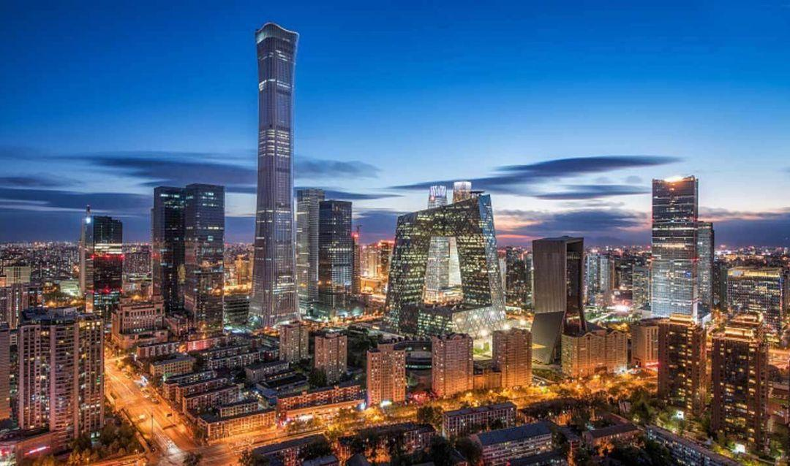
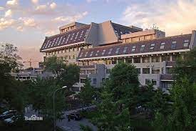
Beijing
Basic Economy
Education
Universities
Peking University — one of the top university in China
Resource and development
Medical resources — hospitals
Non-Basic economy
Malls and restaurants
two of the most flourishing districts in Beijing — Sanli and the International trade center

Slide 4
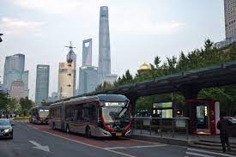
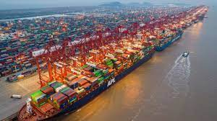
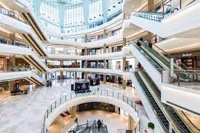
Shanghai
Basic Economic
Commerce
The retail trade in manufactured consumer goods is trading all the way to whole China and it also export to the world. There is a huge harbour to transport goods.
Transportation
Non-basic Economic
Shopping Mall

Slide 5
Reflection
Beijing and Boston shared a lot in common in terms of their economies. Both have similar basic economies. Both have higher education as well as hospitals. Shanghai was slightly different, as their basic economy revolves mostly around the manufacturing of goods. The non-basic economies in all 3 cities were also similar, mostly consisting of shopping and retail.

